Slide 1
Traditional Spanish foods
By: Alex, Sarah, Caallum, and amy

Slide 2
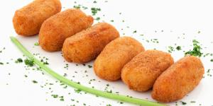
Starters
Spanish food is often recognised as one of the top cuisines in the world, and some traditional Spanish dishes and recipes date hundreds of years.
Spanish starters are renowned worldwide and are eaten in many places outside Spain. Tapas are a huge part of Spanish culture and are used as starters in many Spanish restaurants. Here are some examples of Spanish starters;
Croquetas ~ Croquettes are hugely popular in Spain. They vary from being made of potato, cheese or even ham, and are then breaded and fried.

Slide 3
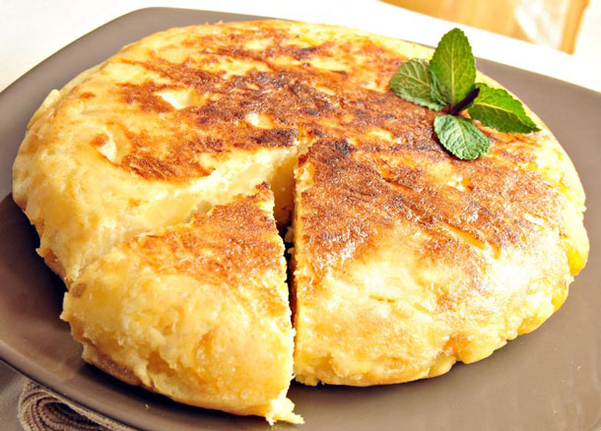
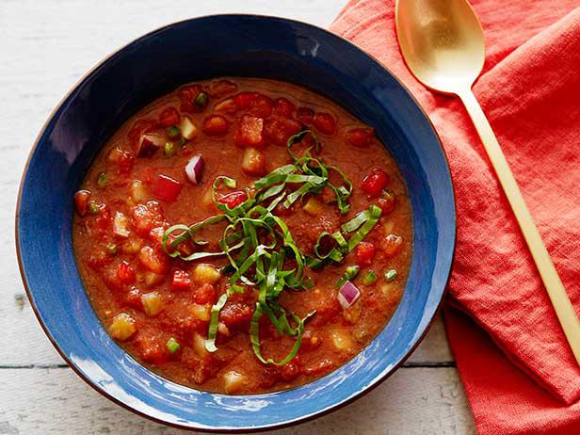
Tortilla Española ~ Tortilla is without a doubt one of the most well known Spanish dishes. It is a variation of an omelette made with egg and potato.
Gazpacho ~ Gazpacho is a cold tomato soup that is eaten all over Spain. You can see it on almost any menu in any Spanish restaurant.

Slide 4
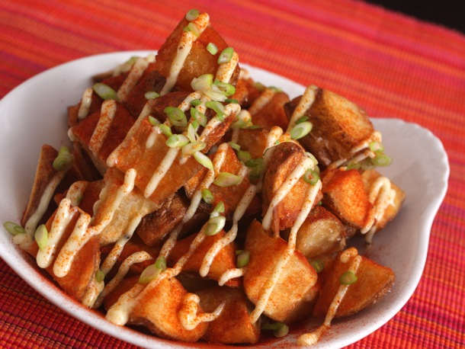
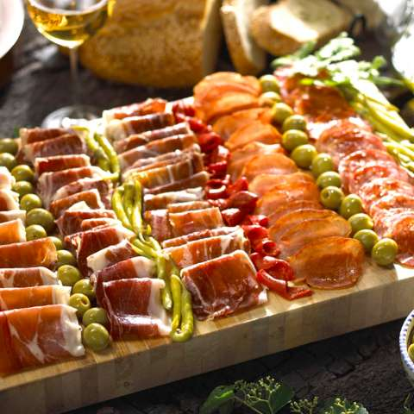
Patatas bravas ~ These potatoes are another native Spanish starter. They are made of cubes of potato in a spicy, tomato sauce.
Cured meats ~ Cured meats, such as jamon and chorizo, are a really popular Spanish starter. They can be eaten on their own or with cheese or bread.

Slide 5
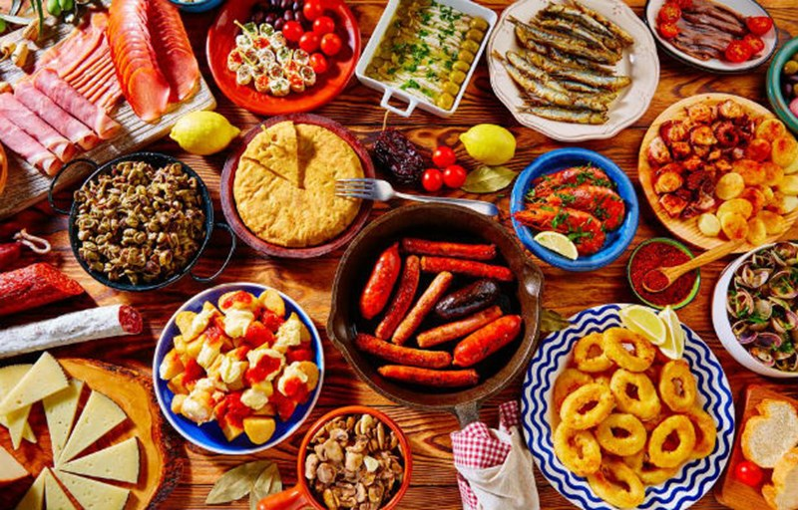
Main courses
A typical Spanish main course meal would include big dishes consisting of rice, meats, chorizo, and plenty of spices. Spanish meals varies as some meals can just be tapas which are small dishes and are usually shared and mixed around with big groups of friends and families. A few popular Spanish dishes are as follows:

Slide 6
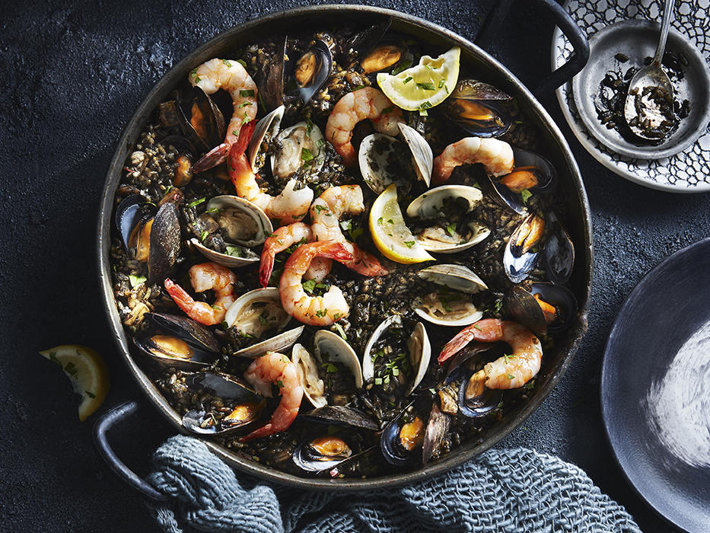
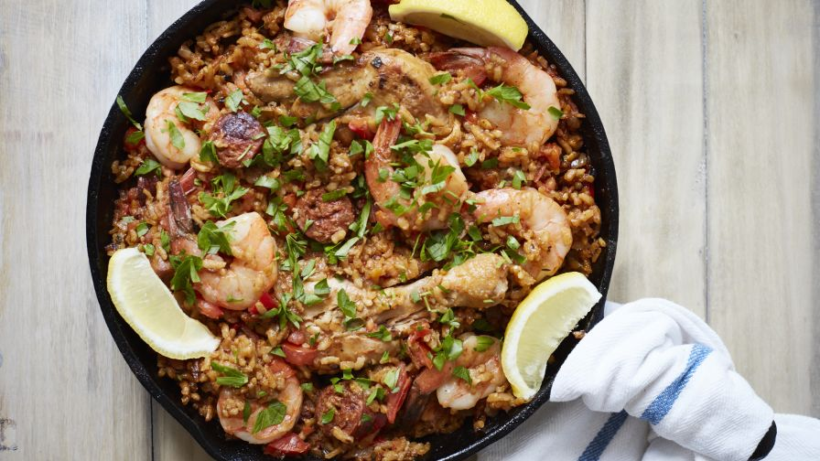
Paella: Paella is a Valencian rice dish with saffron, chicken and seafood that has ancient roots but its modern form originated in the mid-19th century in the area around Albufera lagoon on the east coast of Spain. You can get this dish in lots of different styles such as paella negro, which is seafood paella with squids ink mixed in.

Slide 7
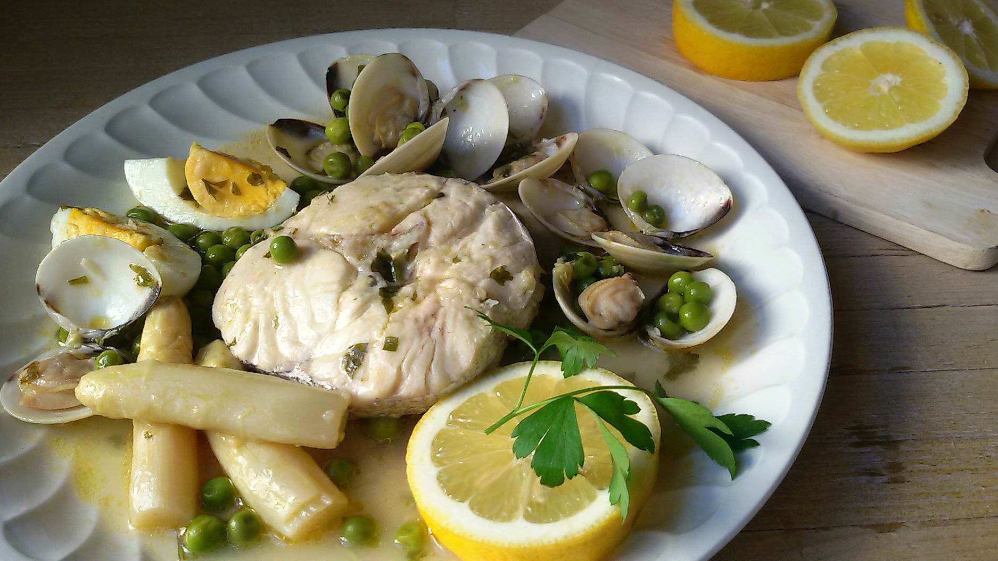
Merluza a la vasca: Hake to the Basque . The Basque hake or hake coskera, is a typical dish of the Basque cuisine, so rich and varied gastronomically speaking. It has many similarities with hake in green sauce but each one having different flavours and textures.

Slide 8
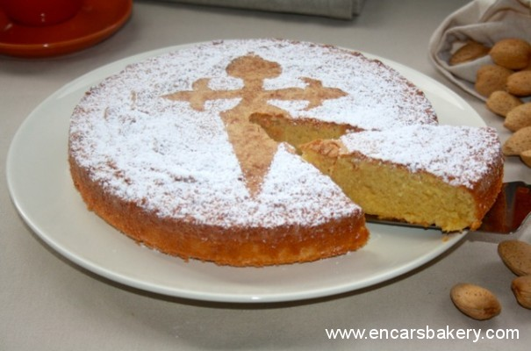
Desserts
Tarta de Santiago
This means Santiago cake and it came from Galicia, however it is consumed all over Spain. Its main ingredient is crushed almonds. This desert actually dates back to as far as 1577. In Spain, this desert is typically not made from scratch and is actually comes pre-made from a box.

Slide 9
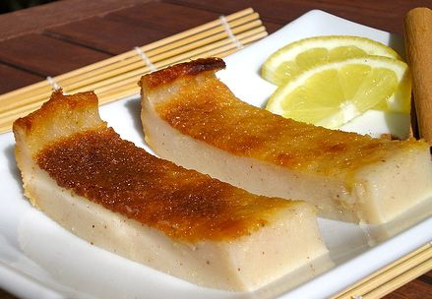
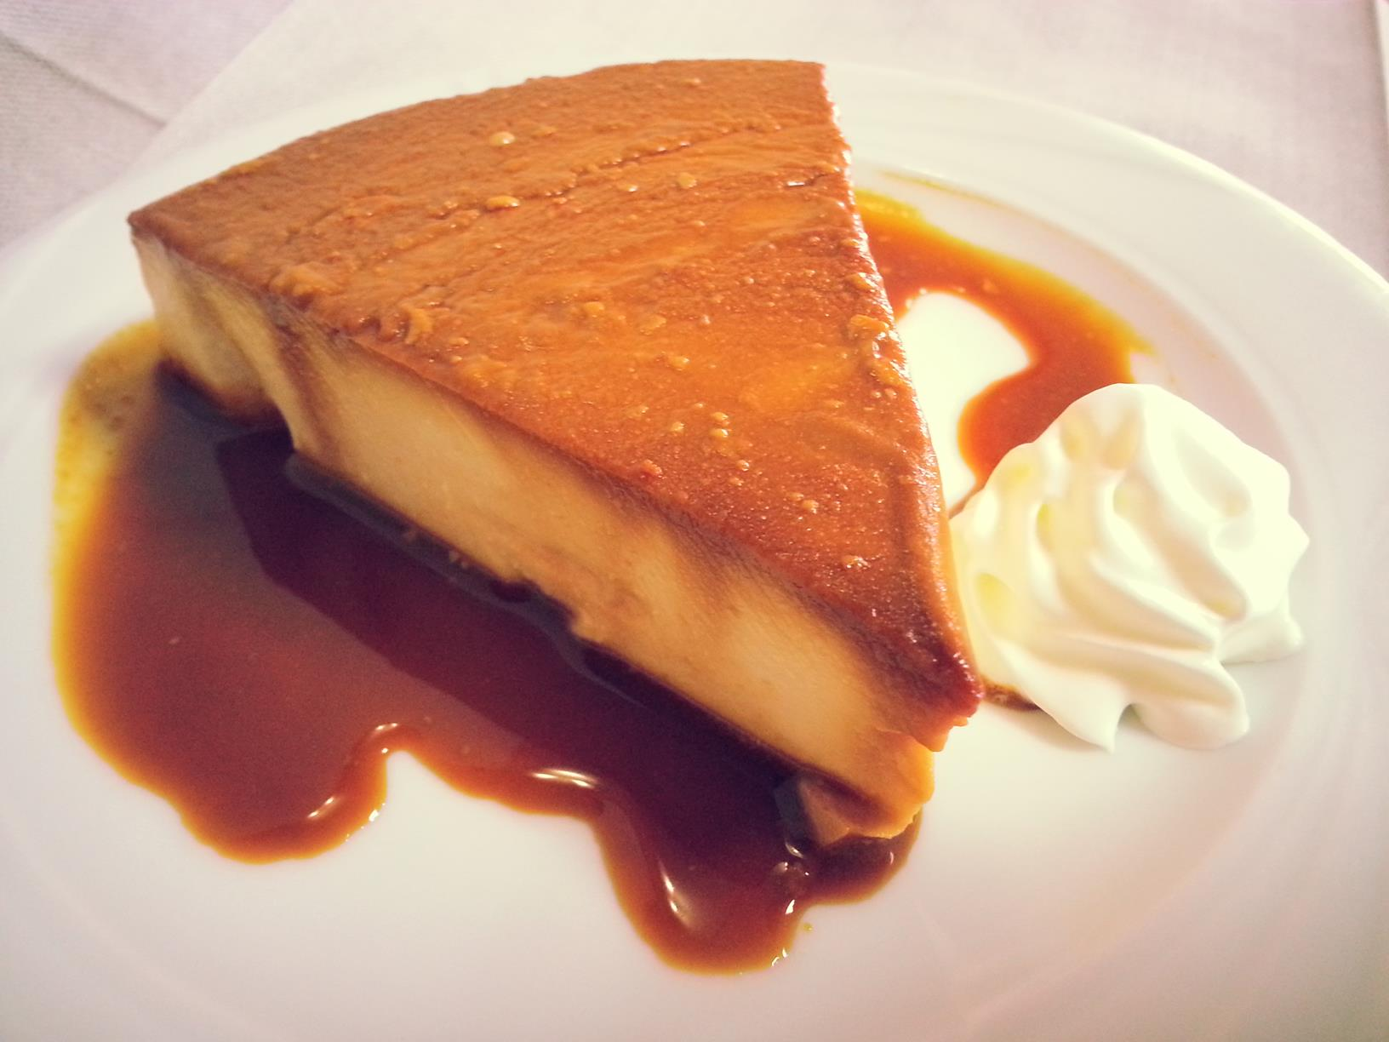
Tarta de Queso
Spanish cheesecake is the very opposite to the New York style cheesecake that we are used to eating. It is light and fluffy and usually has a strong cheese flavor. They also do not always have a base. But when they do, it is usually very dry and crunchy. This desert is usually topped with berries.

Slide 10
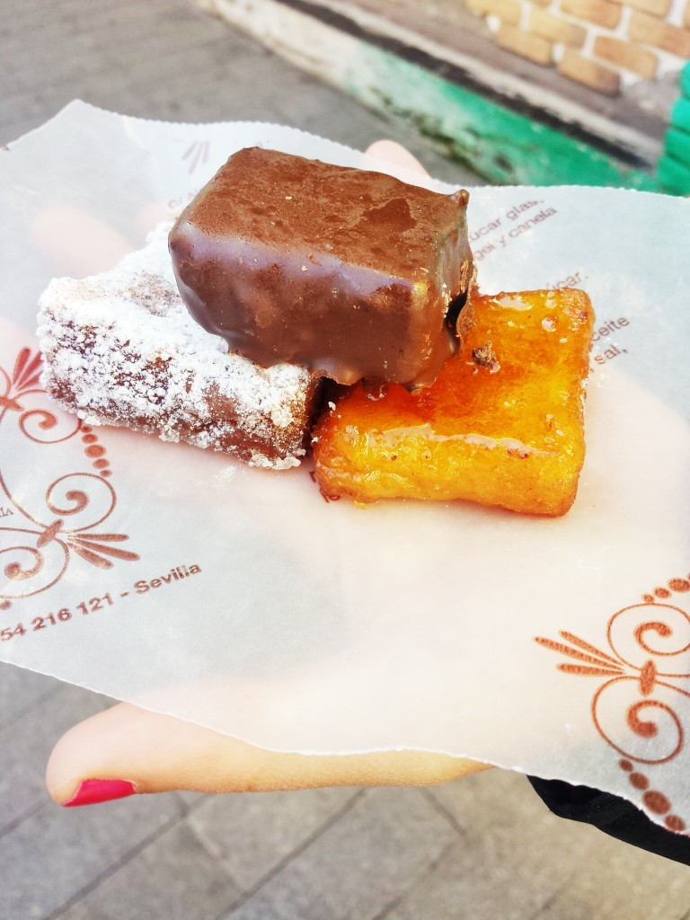
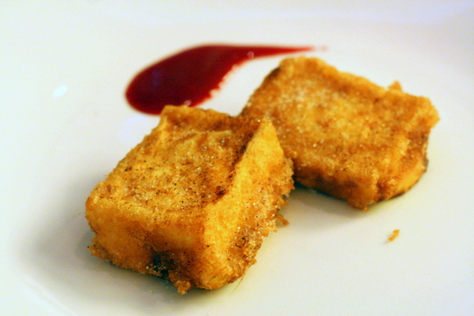
Torrijas
This is a cinnamon-spiced slice of fried bread which can be compared to French toast. This popular dessert can usually only be found around Easter time as this is their traditional Easter dessert. They come in three traditional flavors, milk and cinnamon, wine and maple syrup, or honey soaked.

Slide 11
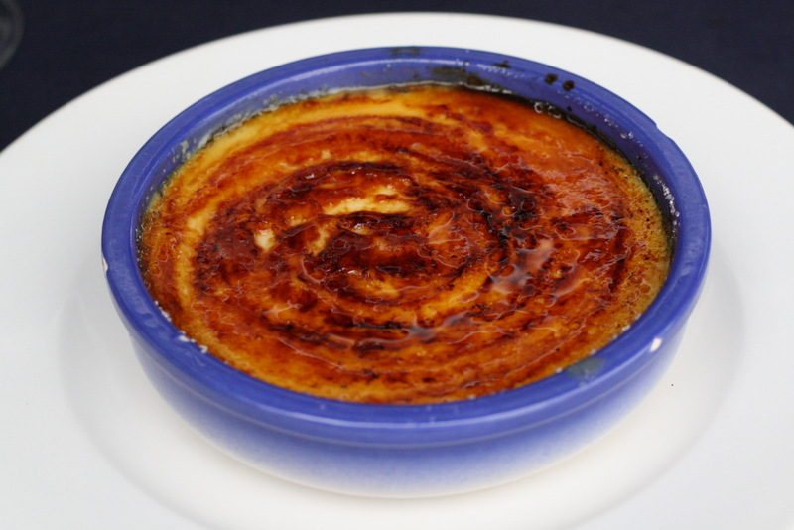
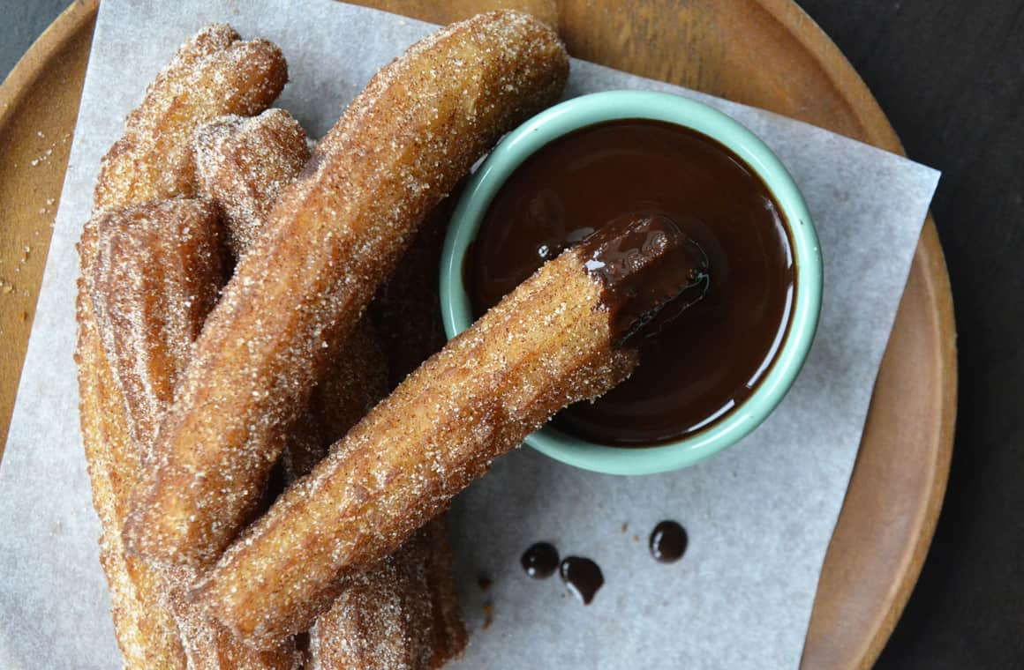
Cream Catalana
Often referred to as “Poor man’s crème brûlée. This is a custard dessert from Catalonia which is served in a shallow dish. It consists of creamy egg yolk custard topped with torched and crispy sugar.
Chocolate and Churros
Churros are tubes of fried dough that are often covered in sugar and cinnamon and then dipped into melted chocolate. While they are considered a dessert, they are often eaten for breakfast and snacks throughout the day.

Slide 12
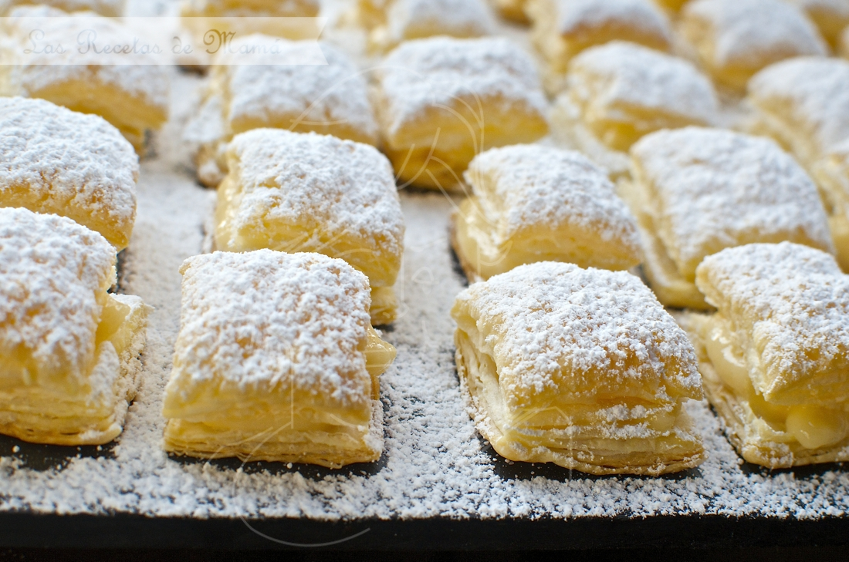
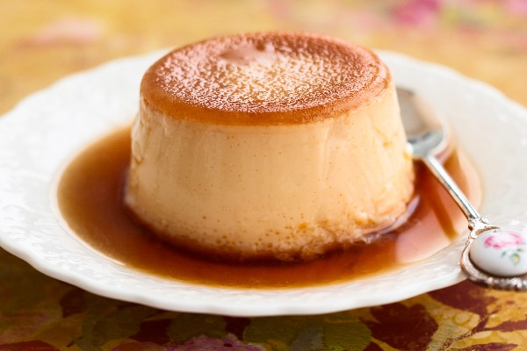
Flan
There are many different types of flan such as vanilla flan, cheese flan, egg flan, chocolate flan, and many more. It is made from milk, sugar and eggs which are then placed in a metal mold that is then placed in hot water. It is then served upside down onto a plate with the top covered in hot caramel.
Miguelitos
These are squares of fluffy phyllo pastry filled with many fillings such as caramel, chocolate, or cream.

Slide 13
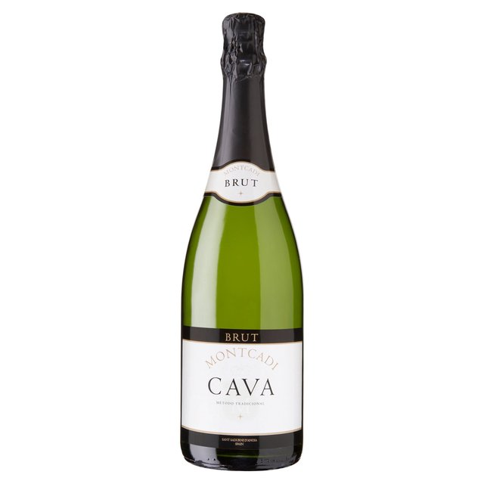
Drinks
Cava
Cava is the Champagne of Spain. Sparkling wines can only be called Champagne if it is from the Champagne region in France, but Spain produces a similar kind, which they call Cava. Catalonia is the most famous region in Spain for producing Cava, with the oldest and largest Cava producers being located there. In fact, most Cava is produced in Catalonia. Available as both blanco (white) and rosando (rosé), Cava is traditionally and often served at celebrations, like at weddings and parties.

Slide 14
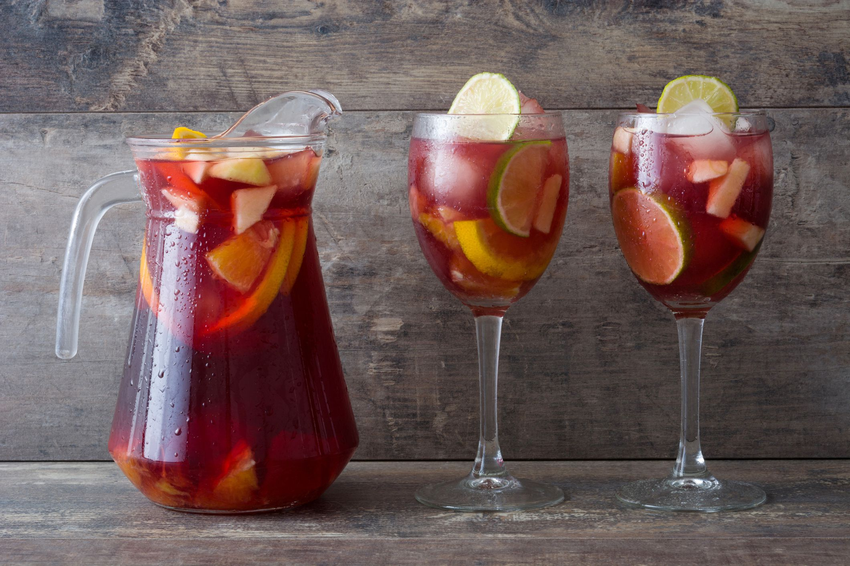
Sangria
Sangria is a famous summertime drink consumed in Spain. The base alcohol is red wine, but brandy and triple sec are also included, with the addition of lemon-lime soda, ice, lemons, oranges and sugar. Sangria is often made in a large bowl or pitcher so it’s often served at parties and gatherings!

Slide 15
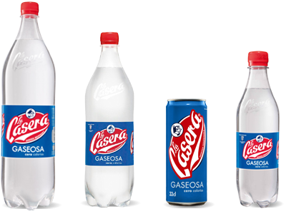
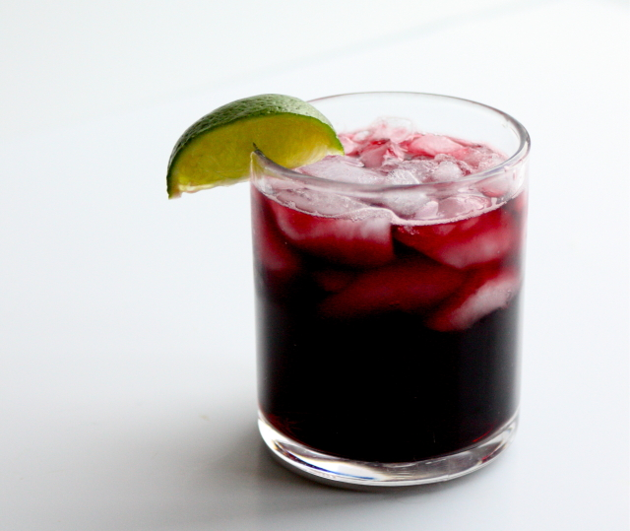
Casera
Casera is a Spanish fizzy drink that can be related to the British 7up. This is my favourite drink to have in Spain. It can only be described as a muted lemon and lime drink. It comes in many different flavours however the original is by far my favorite!
Kalimotxo
Kalimotxo is a drink consisting of equal parts red win and coca- cola . Although recently developed, it has become an icon of Basque culture.
https://youtu.be/qFRgnqA2A44

Slide 16
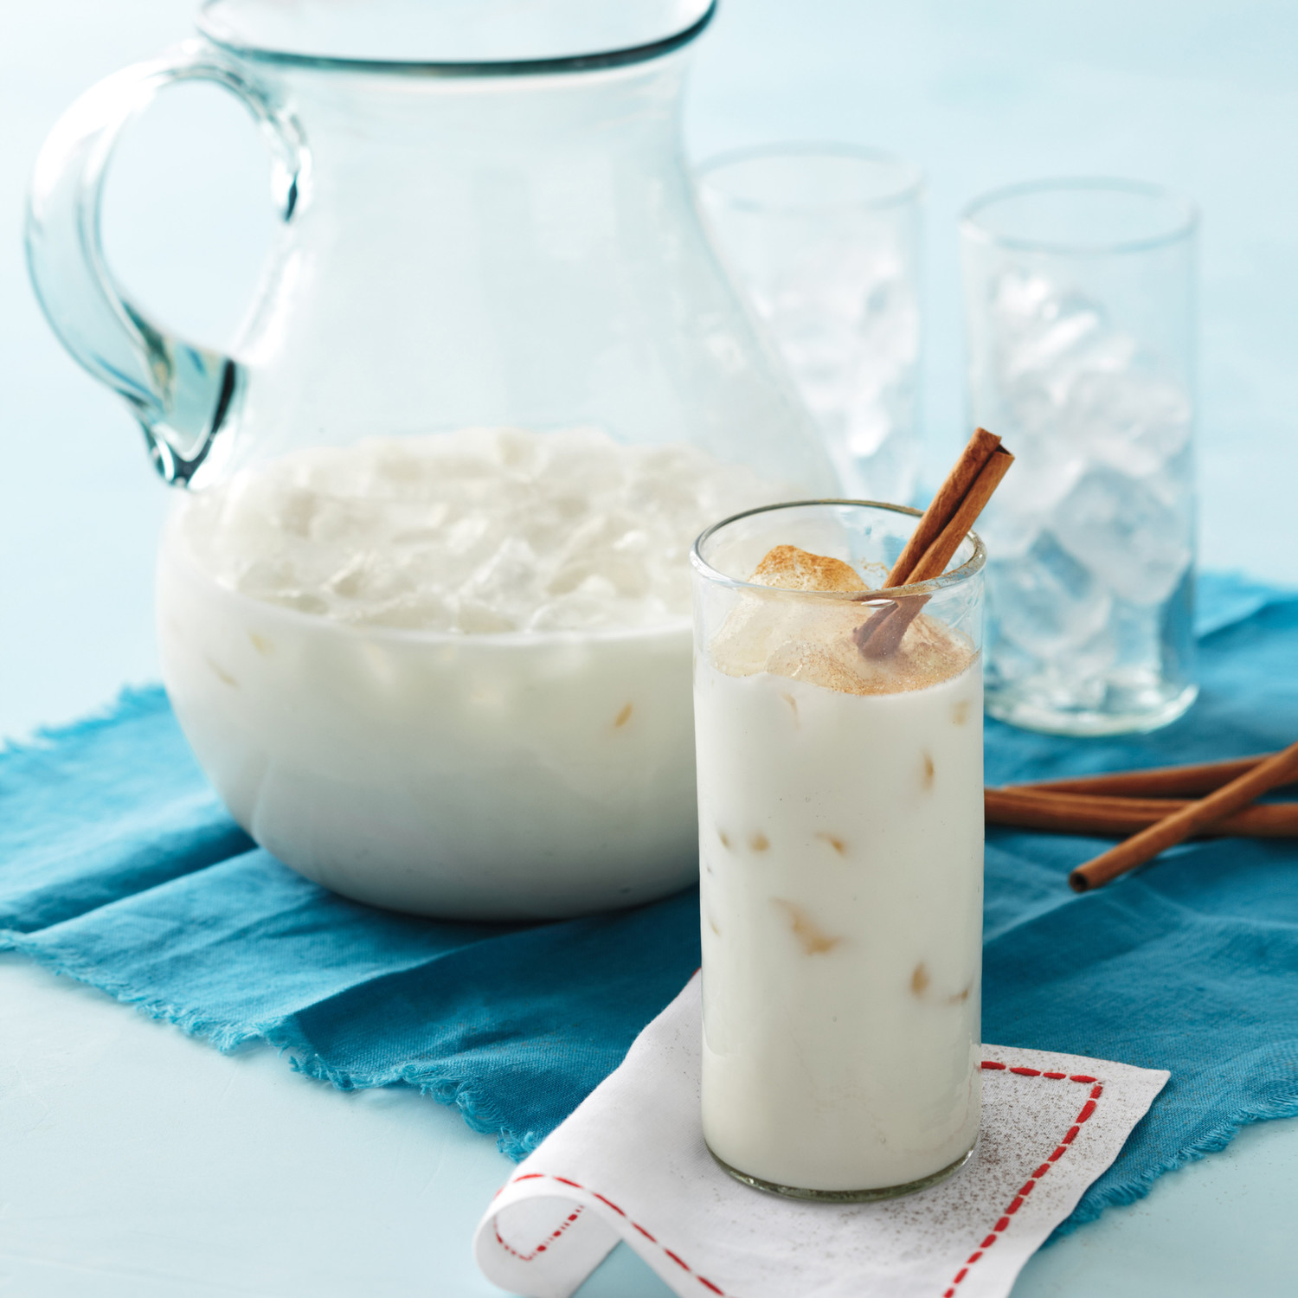
Horchata
You may know of Horchata as the sweet rice drink popular in México, but it actually originates from Valencia in Spain! Valencian Horchata is also a sweet drink with a milky texture, however it is not made from rice but from chufas, or tigernuts. The nuts are purred with water to make the milk and sugar is added to make it sweet. Horchata is a drink always served cold.

